Slide 1

Sales Dataset Analysis
DONE BY:
N.PANDIDURAI
DA & DS,(May)
24/06/2025

Slide 2
PROJECT OVERVIEW
Objective:
To analyze sales data to identify trends, understand performance, and provide business insights.
Choose and reconstruct Features that have impacts on super store Sales.
Goals:
Analyze sales trends over time.
Identify high-performing products and channels.
Evaluate the impact of returns and discounts.
Create a dynamic dashboard with key .

Slide 3
DATA DESCRIPTION AND PREPARATION
Data overview:
Data contains 10000 rows with column such as a Order ID, Sales ID, Product types, Quantity ,Discount, Sales ,etc.
Data cleaning process:
Remove the duplicate rows
Formatting the columns.
Standardized date and currency formats
Number formatting
Cell formatting
Font style Formatting
Working with table

Slide 4
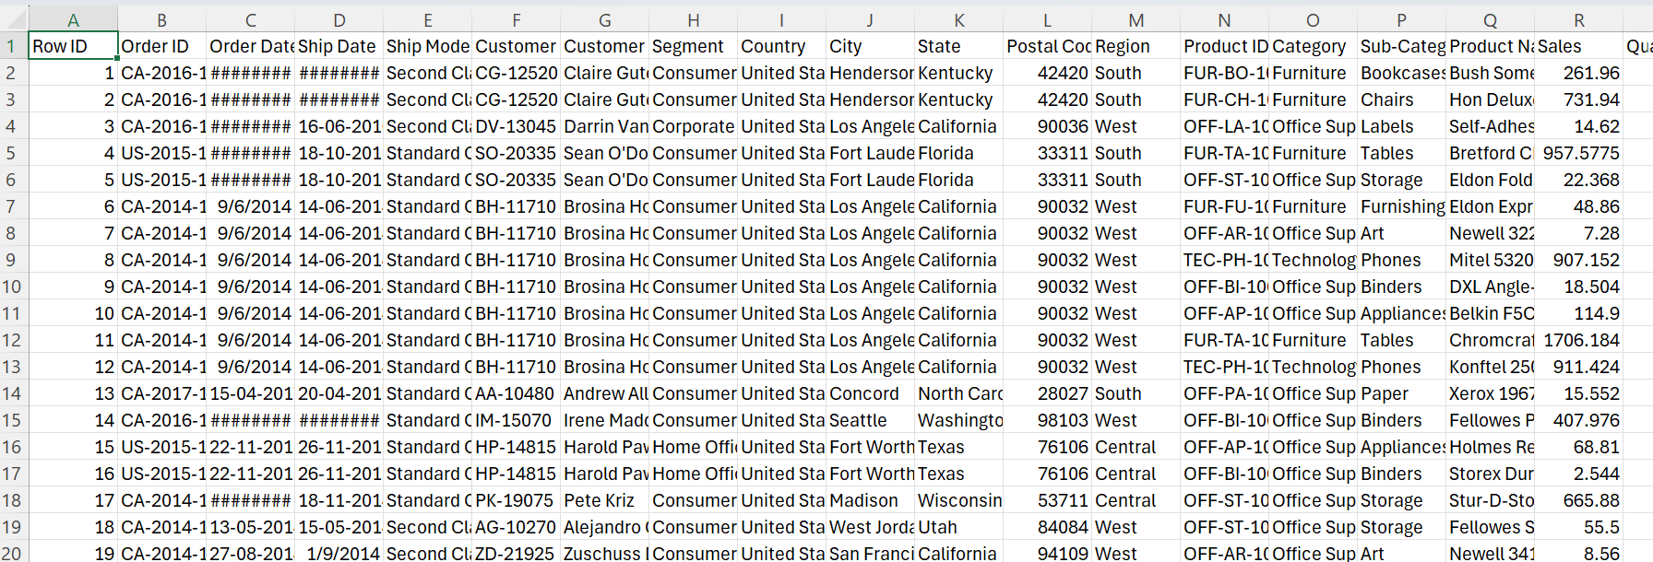
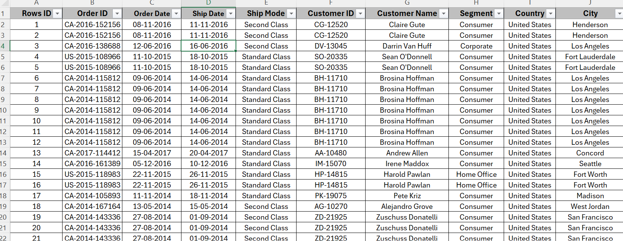
Before: After:

Slide 5
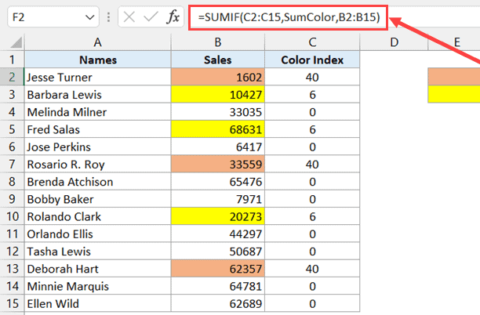
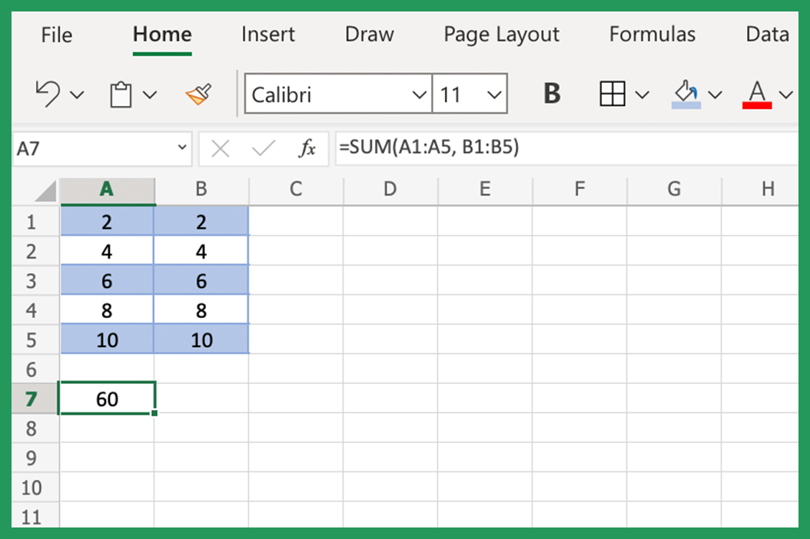
Key Metrics Calculation:
Basic calculations:
Sum
Average
Count
Conditional calculations
SUMIF
AVERAGEIF
COUNTIF

Slide 6

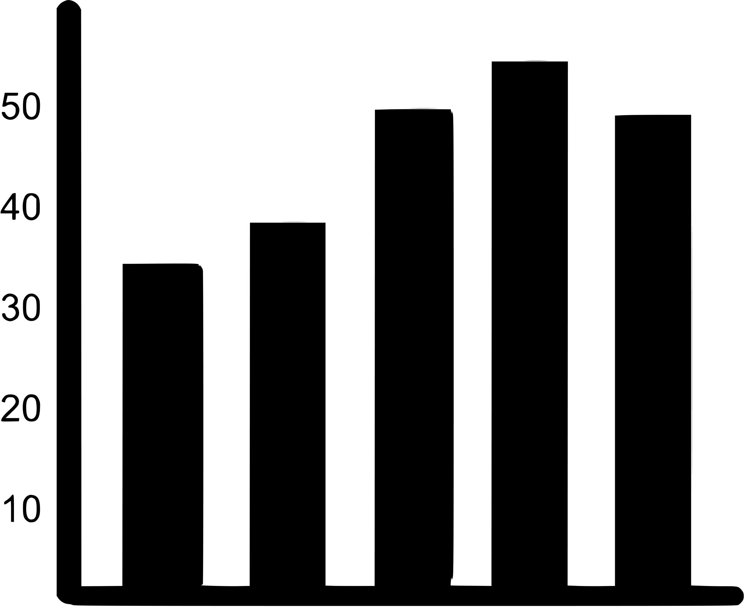
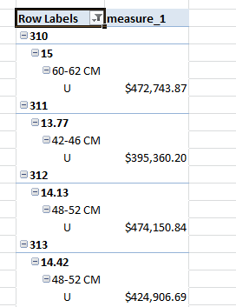
Pivot Table And Pivot Chart
HOW PIVOT TABLE WORKS ?
Data input
Field arrangements
Rows, column ,and values
calculations
How pivot chart works ?
Linked to pivot Tables
Visual representation
interactivity

Slide 7
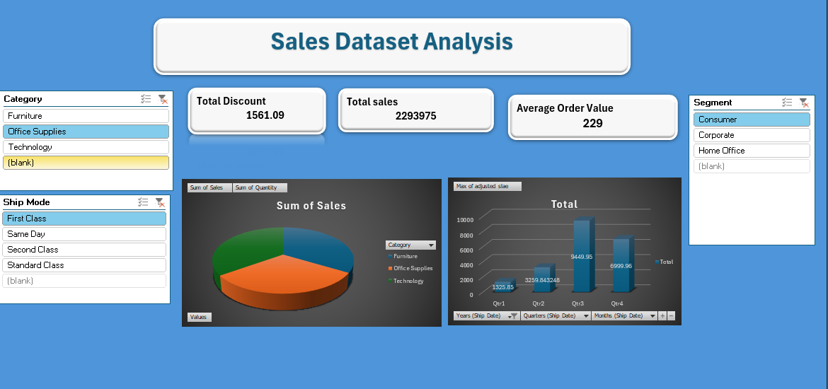
Dashboard overview
Dashboard Design:
Components: KPIs, Slicers, Charts
Purpose: Quick access to business-critical insights
KPIs:
Total Sales
Best-Selling Products

Slide 8
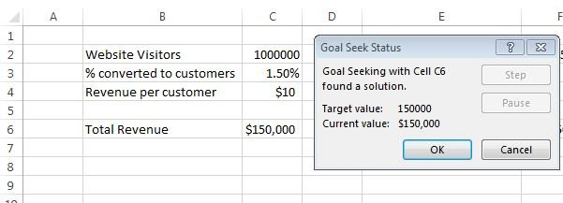
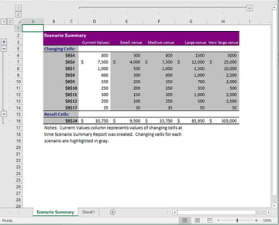
What if analysis & Goal seek
This Photo by Unknown Author is licensed under CC BY-SA-NC
Goal seek is a “what-if analysis "tool that allows you to find the input value needed to achieve a specific result in a formula.

Slide 9
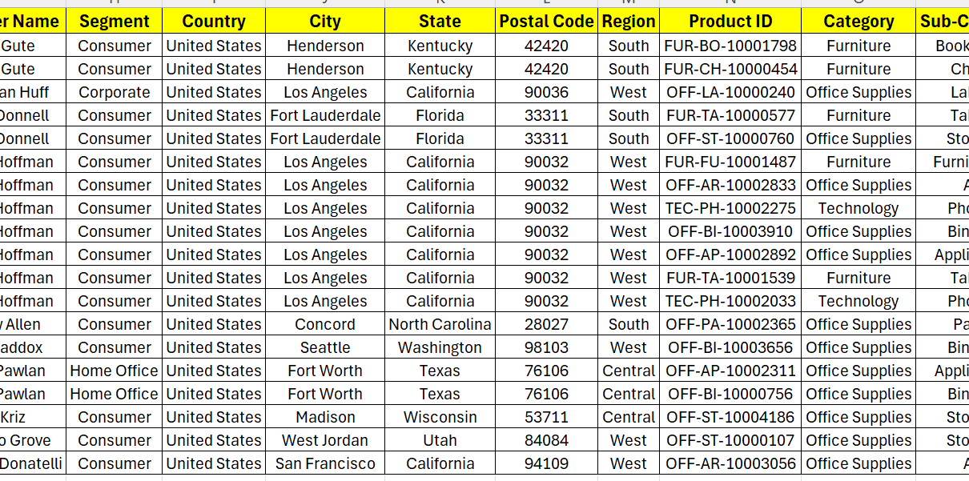
Macro and Automation:
Macro recording: Automated tasks like formatting, KPI updates and chart refreshing
KPI full form key performance indicator
Benefits of macros
Save the time
Improve consistency and efficiency

Slide 10
conclusion:
Summary :
Highlighted sales trends and performance metric
Identified actionable insights for improving business
Next steps:
Predict future Sales
Enhance date quality for more accurate analysis

Slide 11

Thank you

